Slide 1
Slaviša Đurđić
Financials PowerBI Sample Dataset
Goal: Analysis of the “financials” sample dataset.
Instructions:
- Collect data from the Microsoft PowerBI sample dataset.
- Build visuals in Power BI Desktop.
- Run regression analysis in Power BI Desktop and Python.
- Perform One-factor ANOVA hypothesis testing in Python.
Belgrade, August 2023

Slide 2

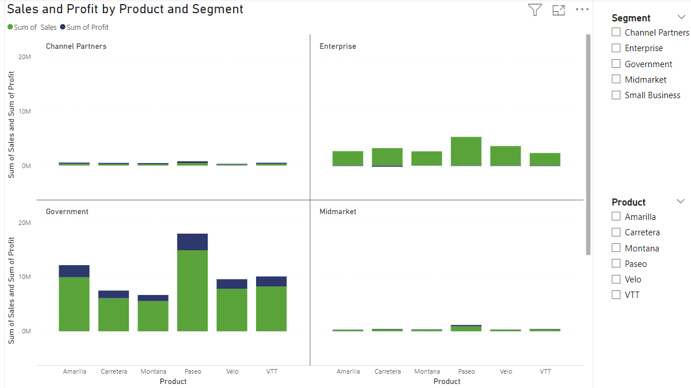
Microsoft Power BI

Slide 3
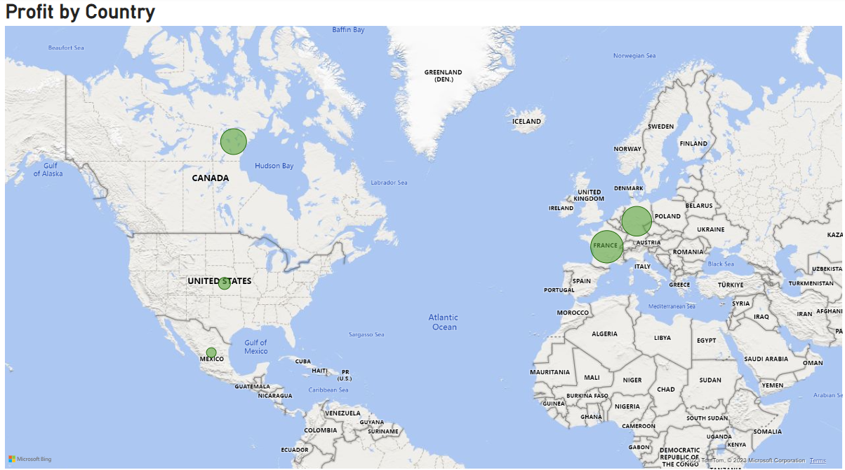
Microsoft Power BI

Slide 4
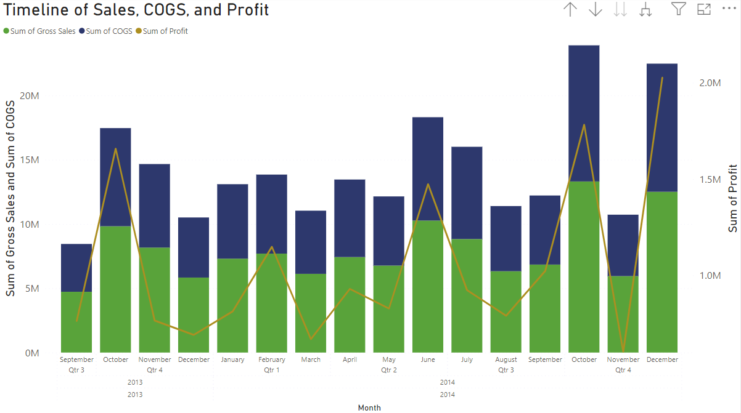
Microsoft Power BI

Slide 5
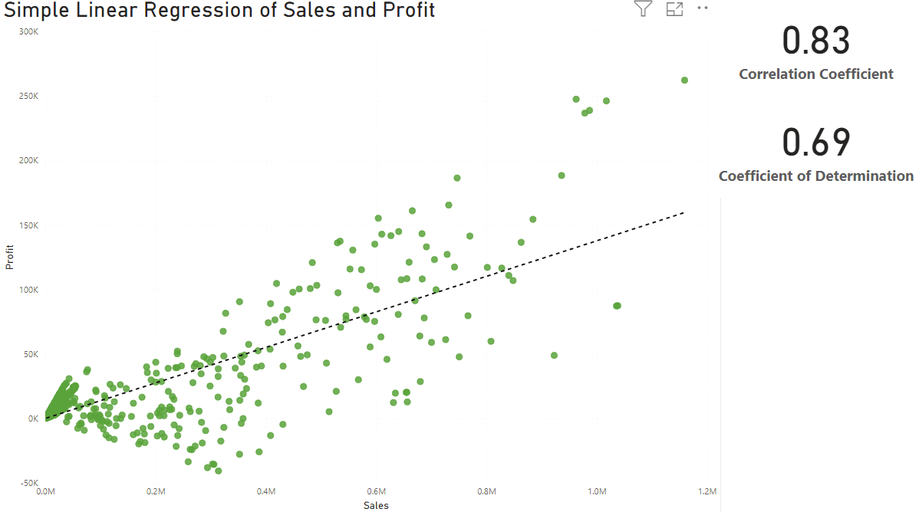
Microsoft Power BI

Slide 6
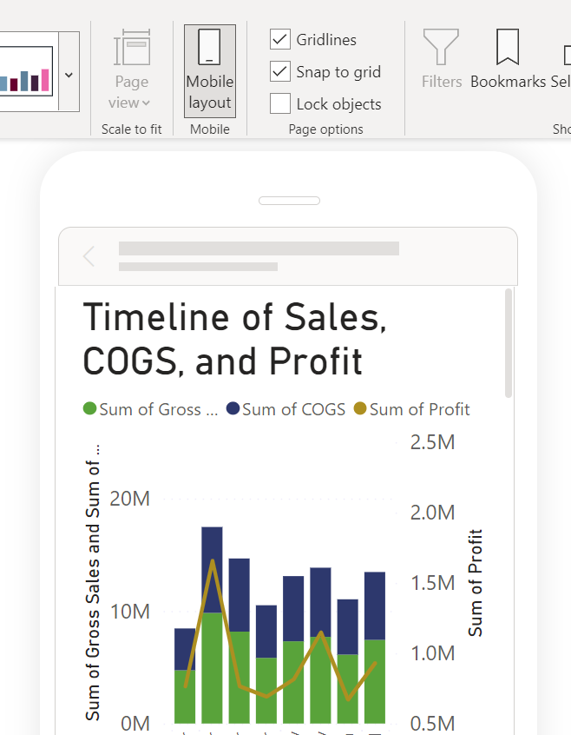
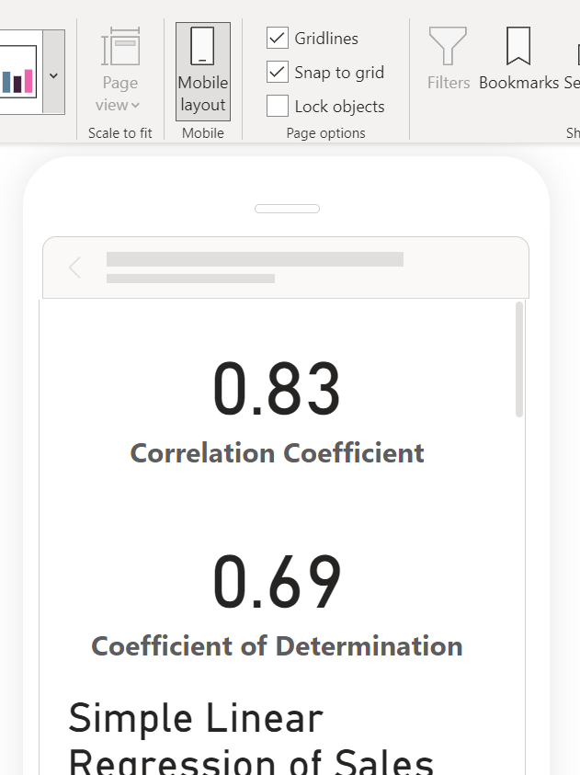
Microsoft Power BI

Slide 7
Financials Project Insights
1) "Government" and "Small Business" segments generate most sales and profit.
2) Profit is more or less equally distributed accros all 5 countries.
3) Financial results are more or less steady over time.
4) Result from the 1-factor ANOVA test is that we cannot reject the hypothesis that all products from "Government" segment generate equal profits.

